Slide 1

North Texas Regional P-16 Council
http://www.ntp16.notlb.com/
A REGIONAL TAKE ON
ACADEMIC AND WORKFORCE ISSUES
Mary Harris, Regents Professor, UNT
V. Barbara Bush, Associate Professor, UNT
M. Jean Keller, Vice President for Community Engagement, UNT
NTCCC Spring Leadership Conference,
January 24 , 2014, Collin College

Slide 2
North Texas Regional P-16 Council
Introduction to the North Texas Regional P-16 Council
Mary Harris

Slide 3
North Texas Regional P-16 Council
P-16 Councils exist to break down “a profound disjunctive and continuing cultural, political and institution chasm between K-12 and higher education.”
Maeroff, Callan, and Usdan, 2001
The Learning Connection

Slide 4
North Texas Regional P-16 Council
The North Texas Regional P-16 Council, along with families, business, faith-based groups, local, state, and federal agencies, and community organizations, works across the levels of education to advance all students and to close the gaps in students' academic achievement from preschool to college and/or career.

Slide 5
North Texas Regional P-16 Council
Members, 2014
Birdville ISD
Collin College District
Communications in Schools Dallas, Inc.
Dallas County Community College District
Dallas ISD
Dallas AfterSchool
DARS/Division for Blind Services
Denton ISD
Education Service Center, Region 10
Education Service Center, Region 11
Educate Texas: Communities Foundation
of Texas
Fort Worth ISD
Grand Prairie ISD
Grayson College
Grayson College
Irving ISD
Joshua ISD
Lewisville ISD
Mesquite ISD
Plano ISD
North Central Texas College
Tarleton State University
Tarrant County College District
Texas A&M University - Commerce
Texas Christian University
Texas Woman’s University
The University of Texas at Arlington
The University of Texas at Dallas
University of North Texas
Weatherford College
United Way of Metropolitan Dallas
United Way of Tarrant County
University Cross Roads
Greater Irving-Las Colinas Chamber of
Commerce
Greater Dallas Chamber of Commerce
Fort Worth Chamber of Commerce
LULAC National Education Service Center
North Texas Community College Consortium
(NTCCC)
North Central Texas Interlink
Workforce Solutions for Tarrant County
5) Marketing Group

Slide 6
North Texas Regional P-16 Council
Closing the gaps in North Texas
Executive Committee
Represents all constituencies
Meets regularly
Monitors state and local
trends

Slide 7
North Texas Regional P-16 Council
Work Groups
Communications and Networking
Funding and Sustainability
Professional Development
Research, Assessment, and
Accountability

Slide 8
North Texas Regional P-16 Council
Annual Accomplishments, 2002-2014
1. Annual gap analysis reports since 2003
2. Quarterly membership meetings focused on pipeline issues
3. Co-Sponsored Best Practices Conferences, 2007, 2008, 2009, followed by Vertical Alignment and Counselor Conferences
4. Negotiation of our role as a regional P-16 council within a statewide network of P-16 Councils
5. Sustainability through external funding

Slide 9
North Texas Regional P-16 Council
Major Strategic Interests
1. Teacher Education pipelines
2. Go Centers
3. Dual credit and concurrent enrollment
4. Early College High Schools
5. Creating college going cultures in high schools
6. Vertical curriculum alignment, STEM
7. Gen TX Week and Gen TX Marketing
8. Implications of House Bill 5

Slide 10
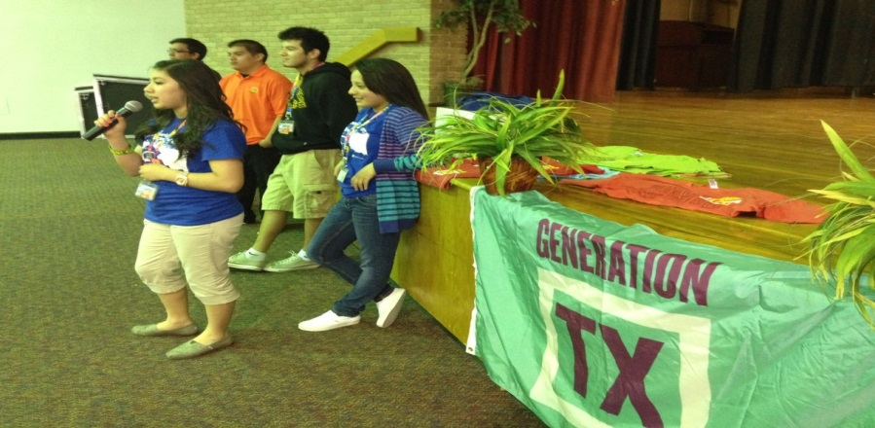
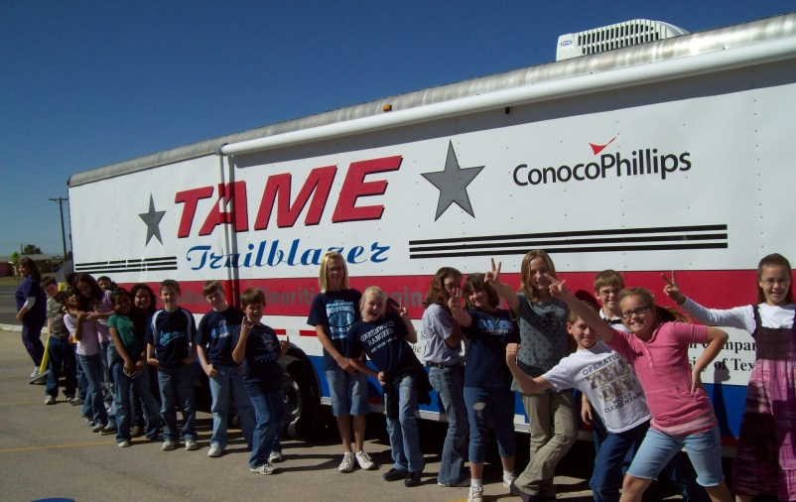
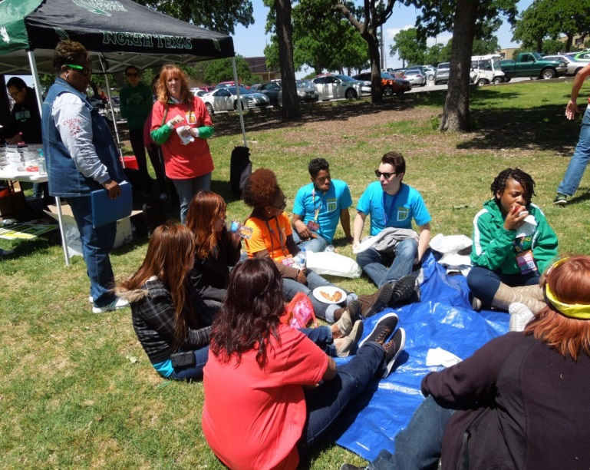
Gen TX Marketing DFW

Slide 11

Gen TX Marketing DFW

Slide 12
North Texas Regional P-16 Council
Gap Analysis Reports and Related Study
V. Barbara Bush

Slide 13
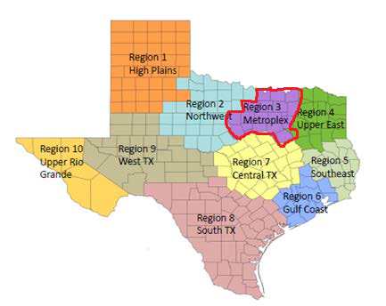
North Texas Regional P-16 Council

Slide 14
North Texas Regional P-16 Council
PURPOSE OF THE GAP ANALYSIS REPORT
Present the performances of ESCs 10 and 11, or Region 3-Metroplex (in Texas Higher Education Regions), on the key indicators related to higher education.
Conduct horizontal gap analysis comparing ESCs 10 and 11/Region 3 to the state on the core indicators.
Identify trends over time for indicators with multi-year data or change on the core data elements for the two most recent data points

Slide 15
North Texas Regional P-16 Council
College Readiness
College-Ready High School Graduates in English Language Arts, Mathematics, and/or Both Subjects and Mean Annual Rate of Change from 2006 to 2011 in State, ESC 10, and ESC 11 (by Ethnicity, by Gender)
SAT/ACT Results of High School Students from 1996 to 2011 in State, ESC 10, and ESC 11
Advanced Course/Dual Enrollment Completion of High School Students from 2003 to 2011 in State, ESC 10, and ESC 11
High School Students Enrolled in Higher Education Dual Credit in 2009, 2010, and 2011 in State and Region 3

Slide 16
North Texas Regional P-16 Council
Higher Education Enrollment
High School Graduates Enrolled in Higher Education from 1996 to 2012 in Four North Texas Counties (Collective)
High School Graduates Enrolled in Higher Education from 1996 to 2012 in Selected North Texas Counties (Individual)
College-Going Rate of High School Graduates Enrolled in Texas Postsecondary Education from 2004 to 2011 in State, ESC 10, and ESC 11 by Ethnicity (by Gender, and by Economically Disadvantaged Status)
Developmental Education
First Time in College (FTIC) Students in 2-year Colleges Requiring Dev. Ed. vs. Those Not Requiring Dev. Ed. in 2007, 2008, and 2009 Cohorts in State and North Texas
First Time in College (FTIC) Students in 4-year Colleges Requiring Dev. Ed. vs. Those Not Requiring Dev. Ed. in 2007, 2008, and 2009 Cohorts in State and North Texas

Slide 17
North Texas Regional P-16 Council
Higher Education Graduation
Public High School Graduates from Classes of 2001-2003, 2002-2004, and 2003-2005 Who Earned a Degree or Certificate within Six Years of High School Graduation in State and Region 3
Employment
Employment Rate and Average Wage in 4th Quarter for First Time in College (FTIC) Graduates of 2-year Colleges from 2009 to 2011 in State and North Texas
Employment Ratio and Average Wage in 4th Quarter for First Time in College (FTIC) Graduates of 4-year Colleges from 2009 to 2011 in State and North Texas

Slide 18
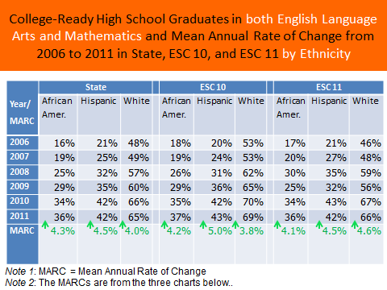

Slide 19
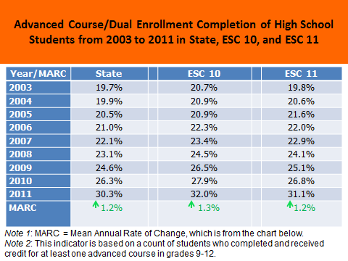

Slide 20
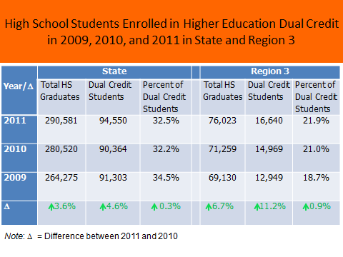

Slide 21
North Texas Regional P-16 Council
AVATAR: Academic Vertical Alignment and Renewal
M. Jean Keller

Slide 22
AVATAR is a statewide network of regional partnerships, focused on secondary and postsecondary vertical course alignment, to support students’ college and career readiness and success.
AVATAR is a Texas Higher Education Coordinating Board (THECB) funded project that is implemented by the North Texas Regional P-16 Council and the University of North Texas and it is in its third year.

Slide 23
A Need for AVATAR?
Too many secondary and postsecondary leaders and educators lack shared and accurate information and understanding of what a student must know and do to be successful in postsecondary education and careers;
Too many students enter postsecondary education but do not complete in a timely fashion; and
Too many students take developmental education at the postsecondary level.

Slide 24
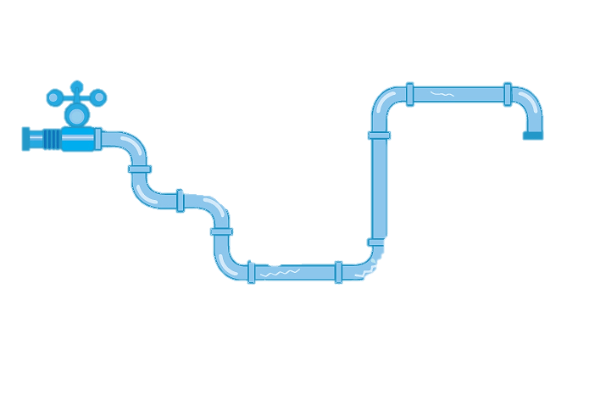
Texas Public 4 Year University Pipeline:
Fall 2005 Cohort
In 2011, No Longer Enrolled:
28 Full-Time
2 Part-Time
4 YEARS
Graduated by 2009:
27 Full-Time
0 Part-Time
In 2005, 100 Enroll:
96 Full-Time
4 Part-Time
6 YEARS
57
Graduated by 2011:
29 Full-Time
1 Part-Time
Out of every 100 students earn a degree
within 6 years
In 2011, Still
Enrolled:
12 Full-Time
1 Part-Time
PUBLIC UNIVERSITIES ENROLLMENT – 61,879
Data Retrieved from: 2013 Texas Public Higher Education Almanac

Slide 25
Texas Public 2 Year College Pipeline:
Fall 2005 Cohort
In 2011, No Longer Enrolled:
29 Full-Time
30 Part-Time
3 YEARS
Earned an Associate’s or Certificate by 2008:
6 Full-Time
3 Part-Time
4 - 6 YEARS
In 2005, 100 Enroll:
51 Full-Time
49 Part-Time
Earned an Associate’s or Certificate 2009-2011:
9 Full-Time
9 Part-Time
27
Out of every 100 students earn a degree
or certificate
within 6 years
In 2011, Still
Enrolled:
7 Full-Time
7 Part-Time
PUBLIC COLLEGE ENROLLMENT – 106,660
Data Retrieved from: 2013 Texas Public Higher Education Almanac

Slide 26
How Does
Work?

Slide 27
Partnerships & Teams:
High Schools
2 Year IHEs
4 Year IHEs
Scaffolding
Student
Success
Regional ESCs
Regional P-16
Councils

Slide 28
Critical Conversations
Secondary
Post-Secondary
Graduate College/Career Ready
Graduate Career Ready
Student Success Assessments
Dual Credit, Early College High Schools
Student Support Services
Educational Policies and Practices
Classroom Instruction, Textbooks,
Grading, etc.
Discipline Specific Course
Curriculum
Texas Essential Knowledge
and Skills
Impact of Developmental Education and
Texas Success Initiative
Dual Credit, Early College High Schools
Student Support Services
Educational Policies and Practices
Classroom Instruction, Textbooks
Grading, etc.
Discipline Reference Course
Profiles
College & Career Readiness
Standards

Slide 29
The Statewide Network
Mathematics
ESC 2, Citizens for Educational Excellence, TAMU-Corpus Christi, Del Mar College, & Calallen ISD.
ESC 9, Midwestern State University, Vernon College, Burkburnett ISD, Wichita Falls ISD, Iowa Park CISD, and Vernon ISD.
ESC 10, Dallas CCCD, Brookhaven College, & Dallas ISD.
ESC 14, Abilene Regional P-16 Council, Cisco College, Ranger College, Western Texas College, Abilene Christian University, McMurry University, Roscoe Collegiate ECHS, Albany ISD, Anson ISD, Clyde-Green Springs ISD, Cooper ISD, Merkel ISD, Wylie ISD, & Roscoe ISD.
ESC 16, Panhandle P-16 Council, West Texas A&M University, Amarillo College, Clarendon College, Frank Phillips College, Amarillo ISD, Borger ISD, & Canyon ISD.
Region 20, P16 Plus Council of Greater Bexar County, UT-San Antonio, San Antonio College, Palo Alto College, & Harlandale ISD.
English Language Arts
ESC 6, Sam Houston State University, Lone Star College System, Buffalo ISD, Magnolia ISD & Huntsville ISD.
ESC 9, Midwestern State University, Vernon College, Burkburnett ISD, Vernon ISD, Iowa Park CISD, & Wichita Falls ISD.
ESC 11, Hill College, & Burleson ISD.
ESC 12, McLennan Community College, Texas State Technical College, Waco ISD, La Vega ISD, Midway ISD, Robinson ISD, Reicher Catholic School, & Baylor University.
ESC 13, Austin Community College, Austin ISD, & St. Edwards University.
ESC 15, San Angelo P-16+ Partnership, Howard College, Angelo State University, Eden CISD, Wall ISD & San Angelo ISD.
Science
ESC 1, Upper Rio Grande Valley P-16, UT-Pan Am, South Texas College, & Pharr San Juan Alamo ISD.
ESC 10, UNT, Dallas CCCD, Brookhaven College, & Dallas ISD.
ESC 11, UNT, TCCD, & Fort Worth ISD.
Awareness
ESC 7, Stephen F. Austin University, Kilgore College, & Kilgore ISD.
Notes:
46

Slide 30
North Texas Regional P-16 Council
Please visit the North Texas Regional P-16 Council website:
http://www.ntp16/notlb.com

